Slide 1
What is plastic pollution and how do we reduce it?
Learning Objectives:
To define plastic pollution
To understand the importance of recycling
To have awareness of recycling in the local area

Slide 2
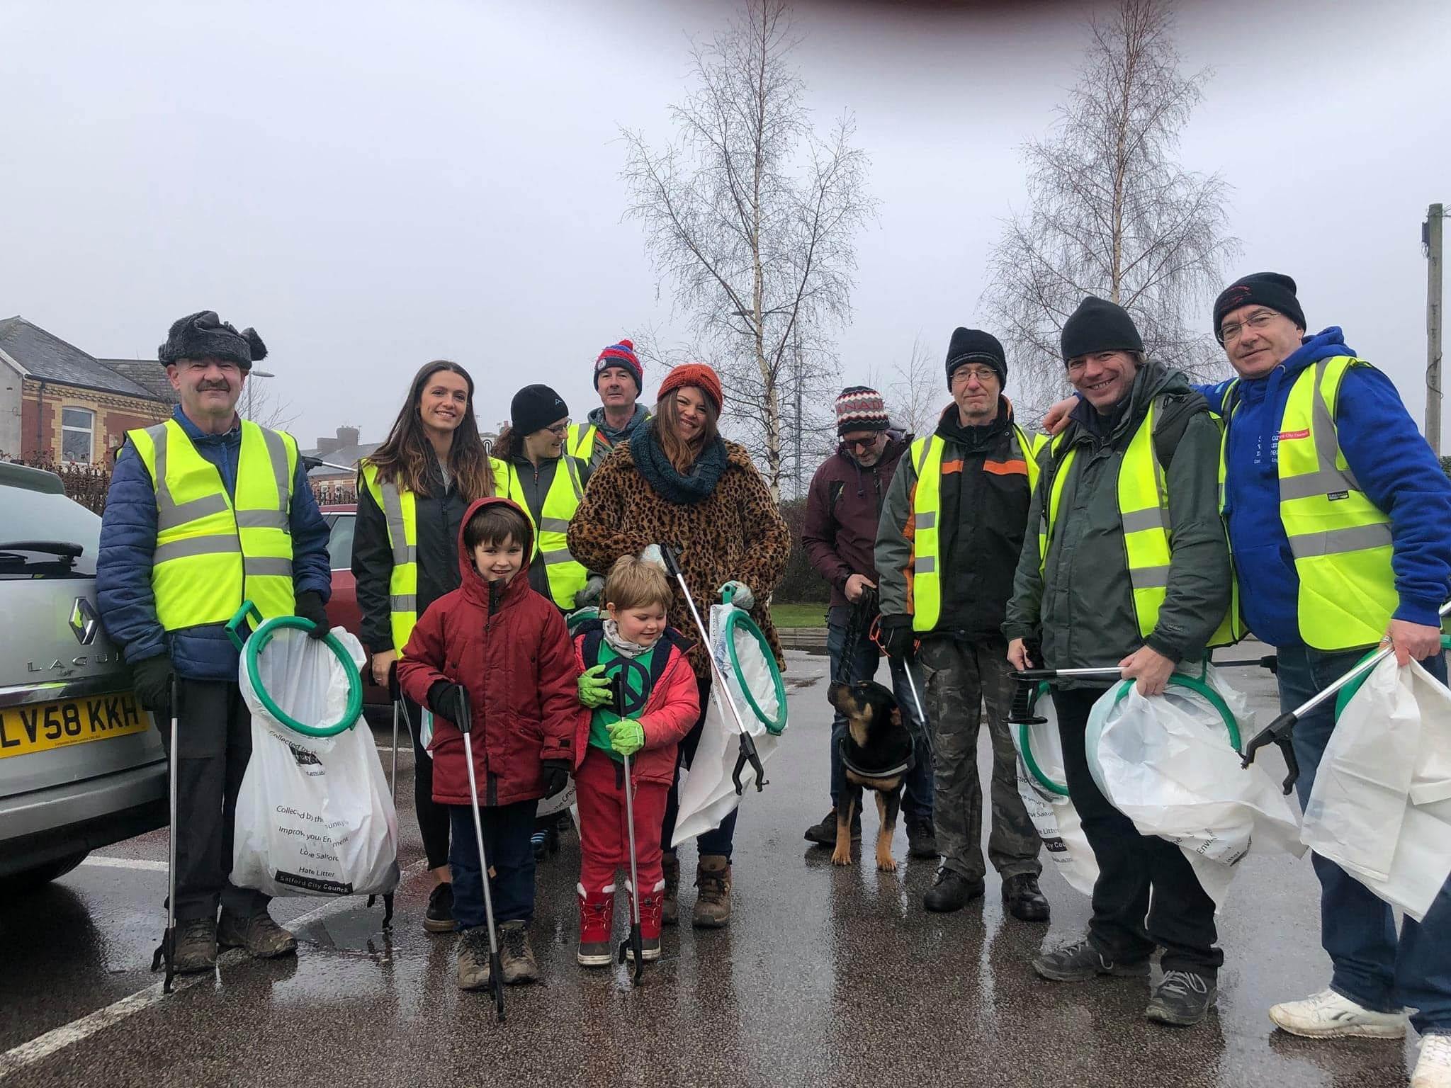
Who is Salford Litter Heroes?

Slide 3
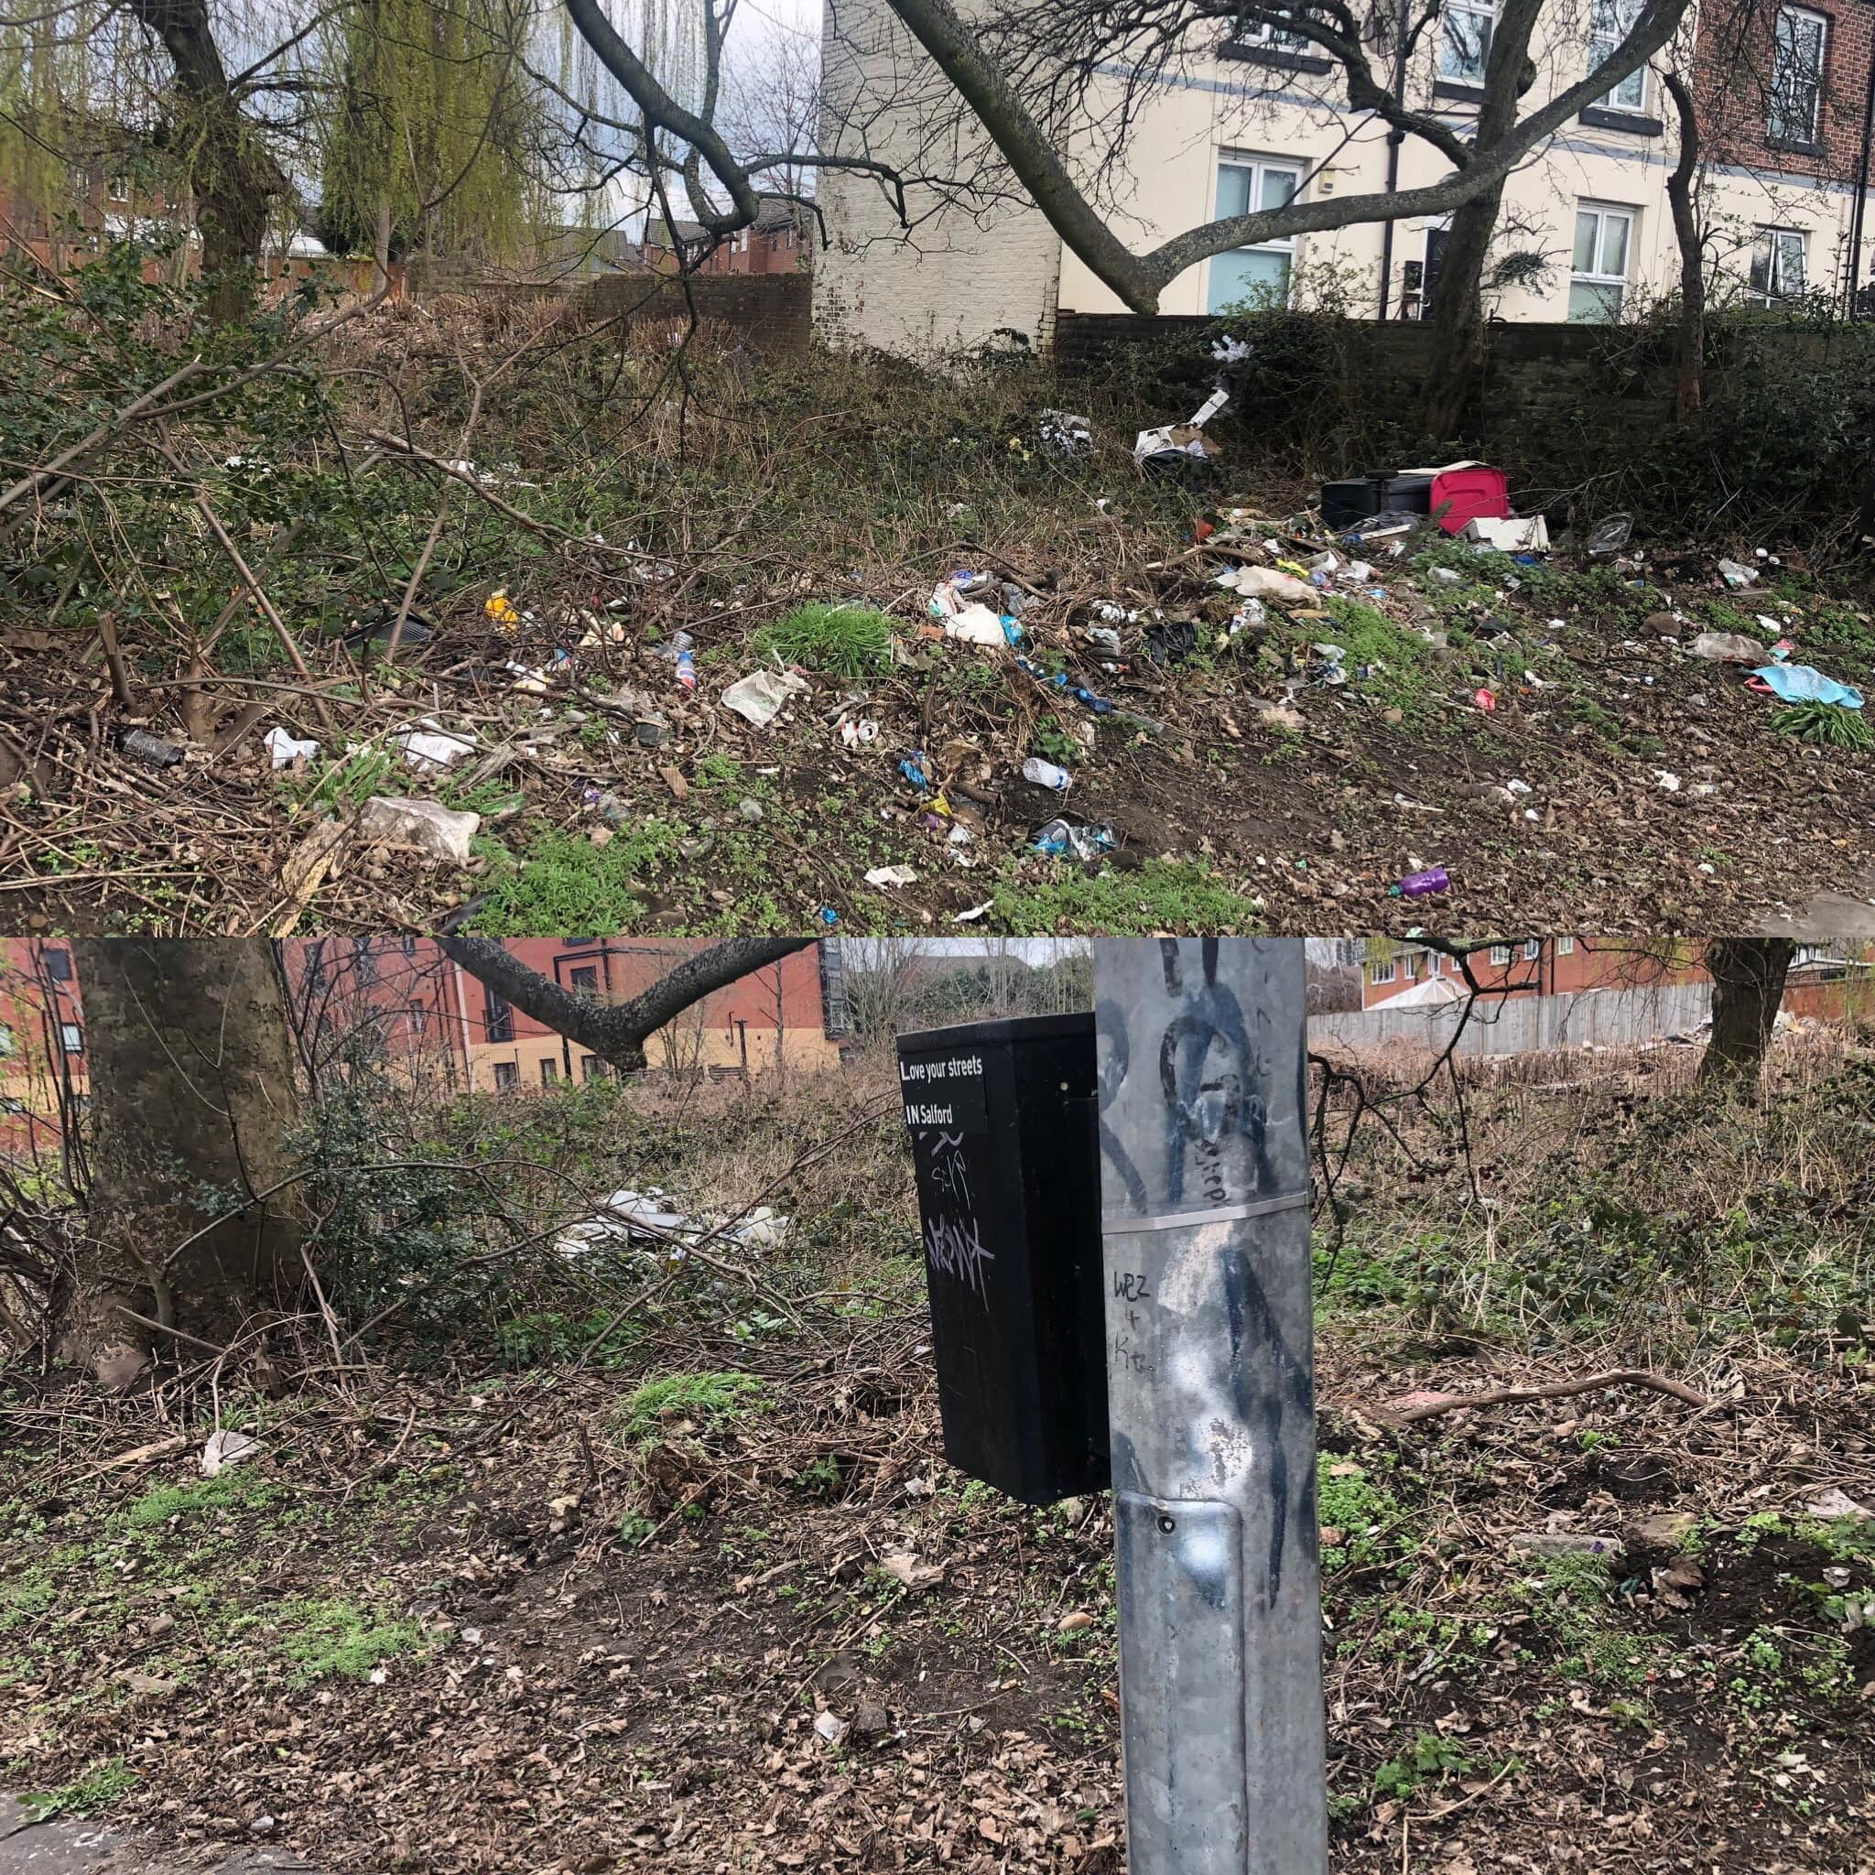

Slide 4
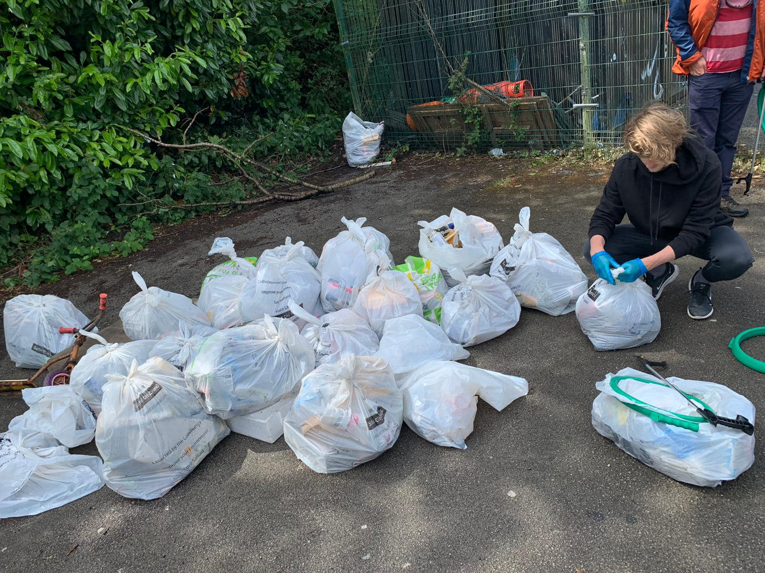

Slide 5
What is plastic pollution?
Notes:
Suggest you want three suggestions from a specific locations around the classroom e.g. front row, middle table

Slide 6
What is plastic pollution?
Plastic pollution is
Excess (too much) plastic in the sea, on beaches, in lakes and rivers.
Plastic bottles and containers now litter the sides of many roads and pose a threat to wildlife and ecosystems.
Notes:
add a picture again for the purpose of dual coding. Show plastic pollution outside your school.

Slide 7
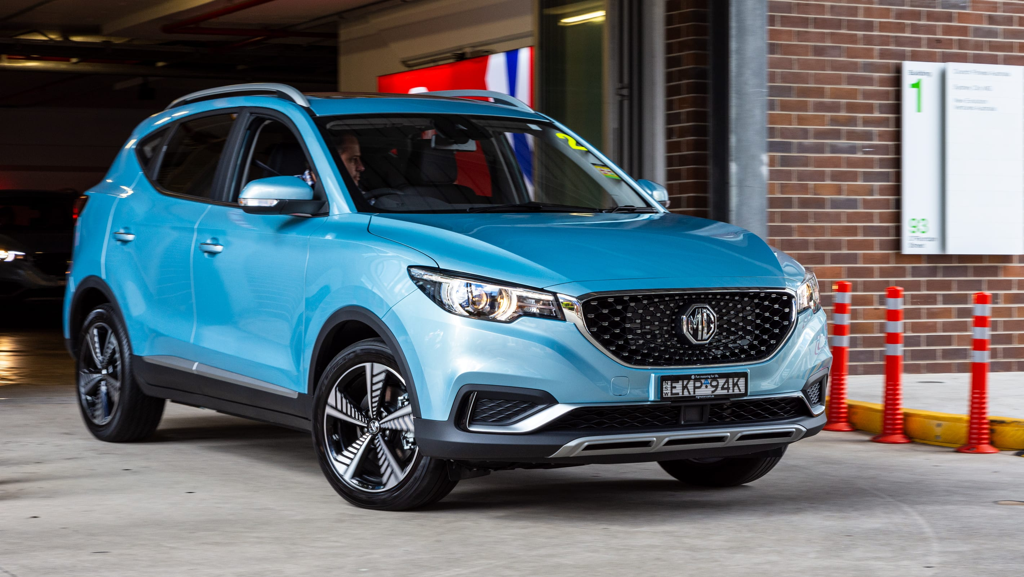
Plastic pollution facts
How many MILLION tonnes of plastic do you think we use in the England every year?
Clue: 1 car = 1 tonne
5 million tonnes
= 5 million cars
5,000,000

Slide 8
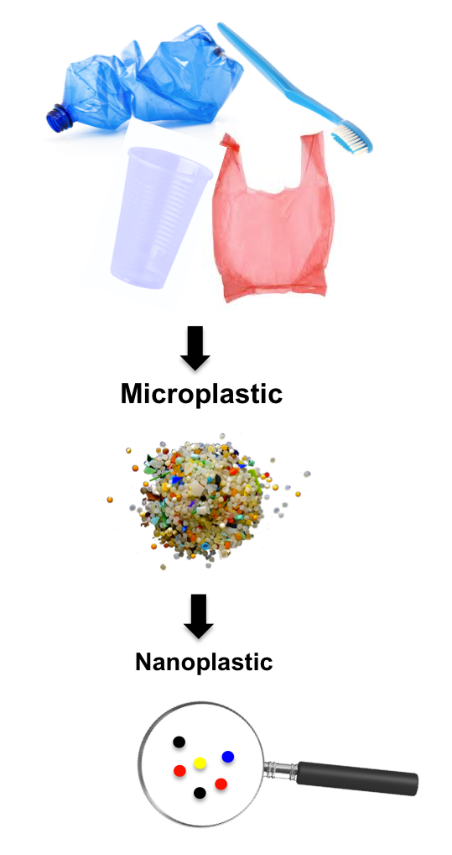
Plastic pollution facts
Plastic is not biodegradable, which means ?
that it doesn’t break down naturally like food waste does. Plastic gets broken up into smaller pieces but doesn’t ever disappear.
Plastic is now found all around the world. Oceans, mountains and ice.

Slide 9
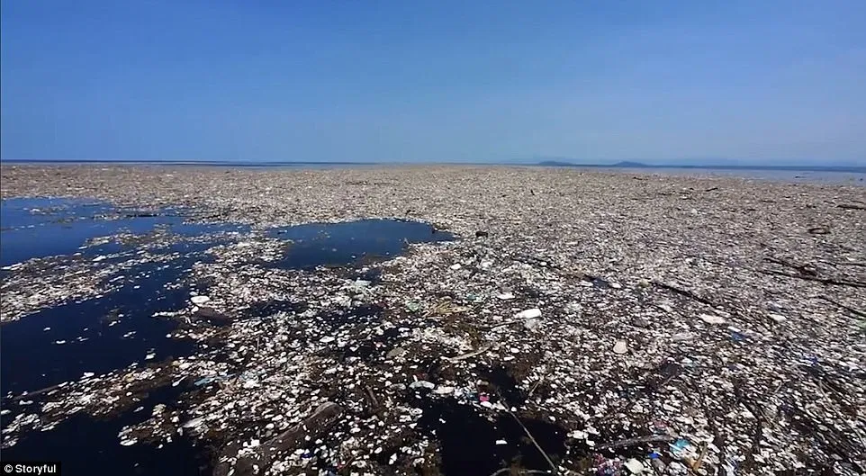
The Great Pacific Garbage Patch
Anyone want to go for a swim?

Slide 10
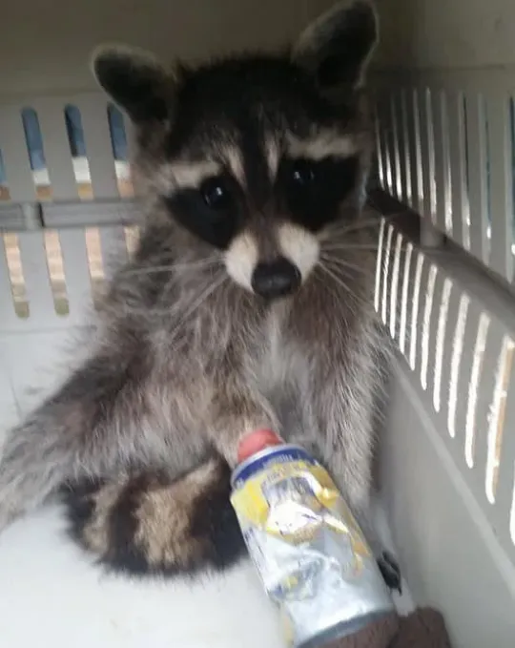
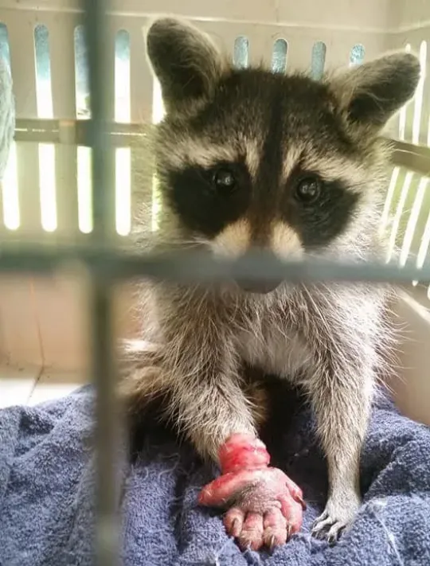
Can you suggest ways to reduce plastic pollution and save the wildlife?
1 person from each table OR row to make a suggestion
Notes:
How will you gain answers from this?

Slide 11
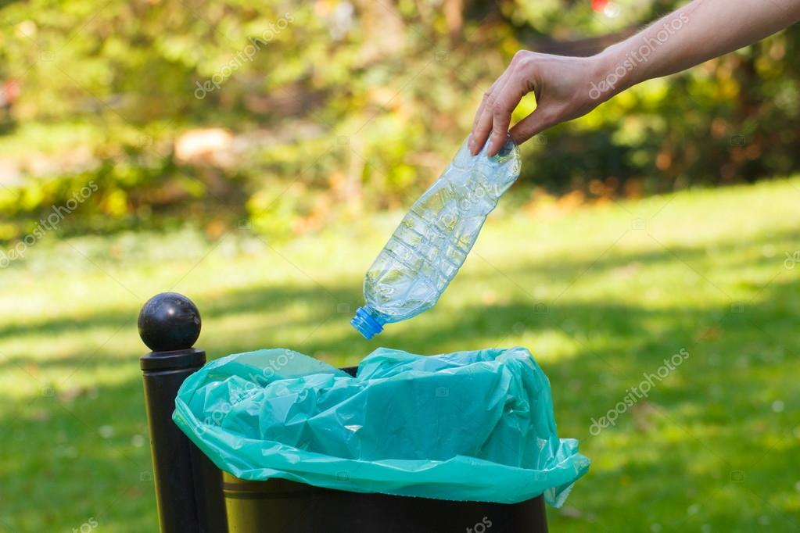
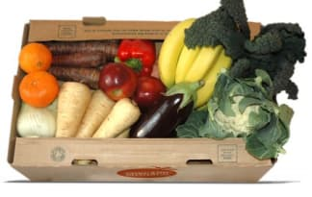
Matching activity
The three R’s
1. Reduce
2. Reuse
3. Recycle
Once you have finished with a plastic bottle, put it in the recycling bin
B) Get vegetables not wrapped in plastic
C) Keep taking the same shopping bag to the shop

Slide 12
Activity: Right stuff, right bin
Salford Recycling bins
General waste
What are these bins used for? Use a sticky note to add a suggestion to the bins

Slide 13
Activity: Right stuff, right bin
Brown Bin = mixed recycling
Blue Bin = paper and card
Pink Lidded Bin= garden waste and food
Brown
Blue
Black with pink lid
Aluminium cans
Empty aerosols
Foil and foil containers
Plastic bottles
Glass bottles
Card board boxes
Juice boxes
Magazines
Cereal boxes
Paper
Leaflets
Uneaten food
Tea bags
Vegetable peel
Flowers and plants (no plant pots or soil)
Bread, cakes and pastries
Fruit and vegetables
Now pick a colouring pencil that is brown, blue or black and pink?
Notes:
Clearly state the time they have on this task, how long is achievable to complete this task?

Slide 14
Choose which coloured bin and write on the title line
2. Complete the box on the left, what items can you recycle in this bin? You can write or draw them
3. Colour in your bin

Slide 15
How to carry out a litter pick
https://youtu.be/WOqPbcEa8bY
Now we know how to carry out a litter pick, lets go be litter heroes and save the world from litter!

Slide 16
Can you make a pledge (promise)?
One thing I will try to recycle more is…
I will ask my parents what we already recycle...
Brown Bin = mixed recycling
Blue Bin = paper and card
Pink Lidded Bin= garden waste and food
Black Bin= general waste

Slide 17
Bin
What is this bin used for? Colour me in

